Slide 1
Functions

Slide 2
1 lesson away from games

Slide 3
What is this function?
1
3
function
53
55

Slide 4
What is this function?
1
3
+2
function
53
55

Slide 5
What is this function?
+2
function
x+2
x

Slide 6
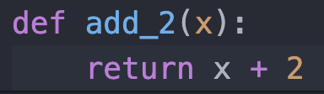
Input x
Output x+2

Slide 7
Define Function
Function Name
Input x (Argument)
Output x+2
Output

Slide 8
What is this function?
10, 15
25
1,2
3
function
11,20
31

Slide 9
What is this function?
1,2
3
+
function
11,20
31

Slide 10
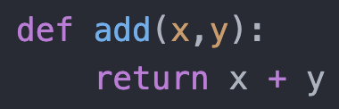
Input x,y
Output x+y

Slide 11
Define Function
Function Name
Input x,y
Output x+y
Output

Slide 12




What is this function?
function

Slide 13
What is this function?
Remove First Element
function

Slide 14
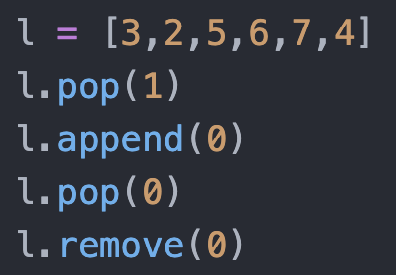
Do you remember which of the following removes the first element?

Slide 15
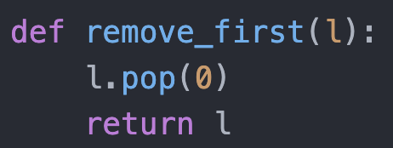
Input l
L pops out first element
Output l

Slide 16
Why do we use functions?
Many lines of codes in one line!
But slow!

Slide 17
Game next week!

